Slide 1
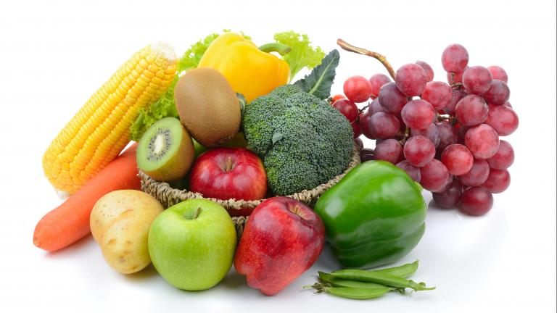

Fruits and Vegetables Classifier with Bangla Nutrition Insights
Syed Salman Sami
DEPT: CSE
SEMESTER: 7th
ID: 0562210005101007
Tufael Ahmed Tamim
DEPT: CSE
SEMESTER: 7th
ID: 0562210005101029
Course: Deep Learning Lab
Course Code: CSE-460
Institution: North East University Bangladesh

Slide 2
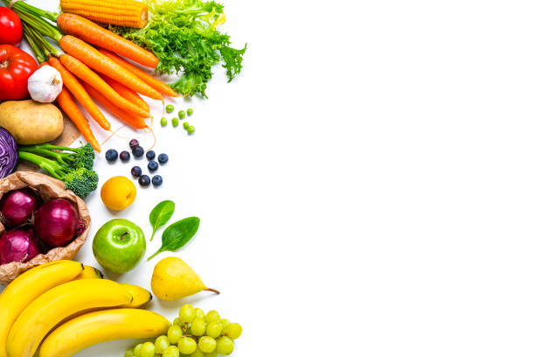
Introduction
Overview
We have built a Fruits and Vegetables Classifier with Bangla Nutrition Insights. Our model can recognize fruits and vegetables from images and show nutrition facts in Bangla.
We used deep learning with TensorFlow and Keras to create this easy-to-use tool.
Streamlit framework for deployment.
Objectives
Build an accurate, efficient image classifier.
Understand deep learning workflow: preprocessing, training, evaluation.
Create a user-friendly application for image classification.

Slide 3
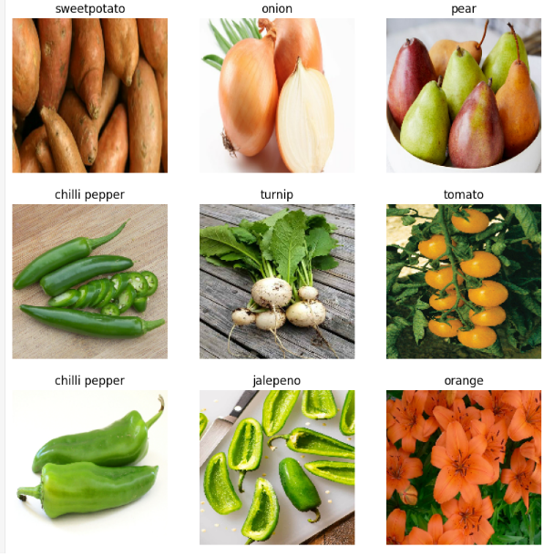
Data Collection & Preprocessing
Data Collection:
We categorized Images into fruits and vegetables.
Organized into folders: training, validation, and test datasets.
Preprocessing Steps:
We resized all images to 180 by 180 pixels for consistency.
We split the data into training, validation, and testing parts.

Slide 4
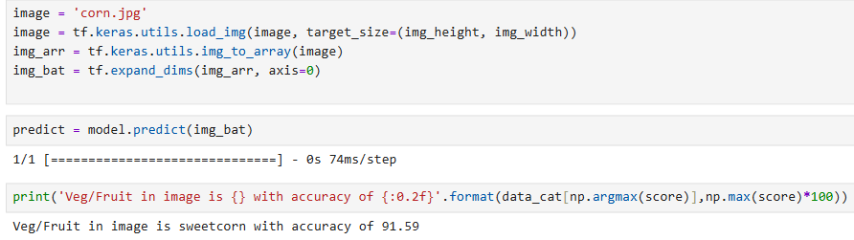
Model Predictions Overview
This is how the model makes predictions.

Slide 5
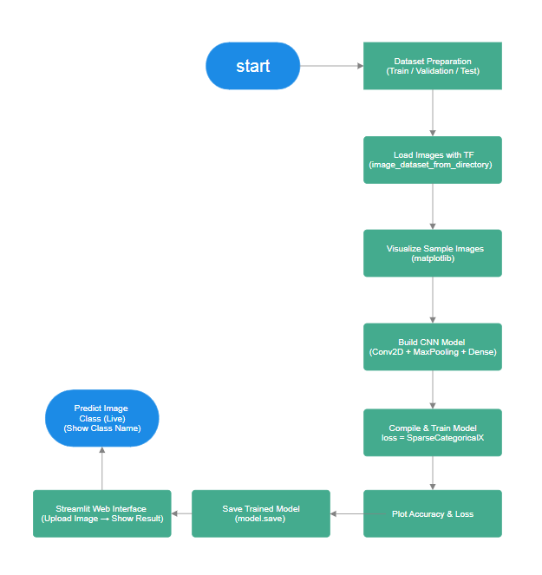
Our Model Structure
We start by preparing the dataset and loading images using TensorFlow. Next, we visualize sample images to understand the data. Then, we build, compile, and train a CNN model. After training, we evaluate accuracy and loss, then save the model, and create a Streamlit web app.
Finally, the app predicts the image uploaded by a user.

Slide 6

Deployment & Future Work
Deployment:
We used Streamlit framework to deploy the model as a web app for easy image classification by users.
Future Improvements:
We will use more data tricks to help the model learn better.
We will add new layers to improve learning.
Will deploy on cloud platforms for wider access.

Slide 7
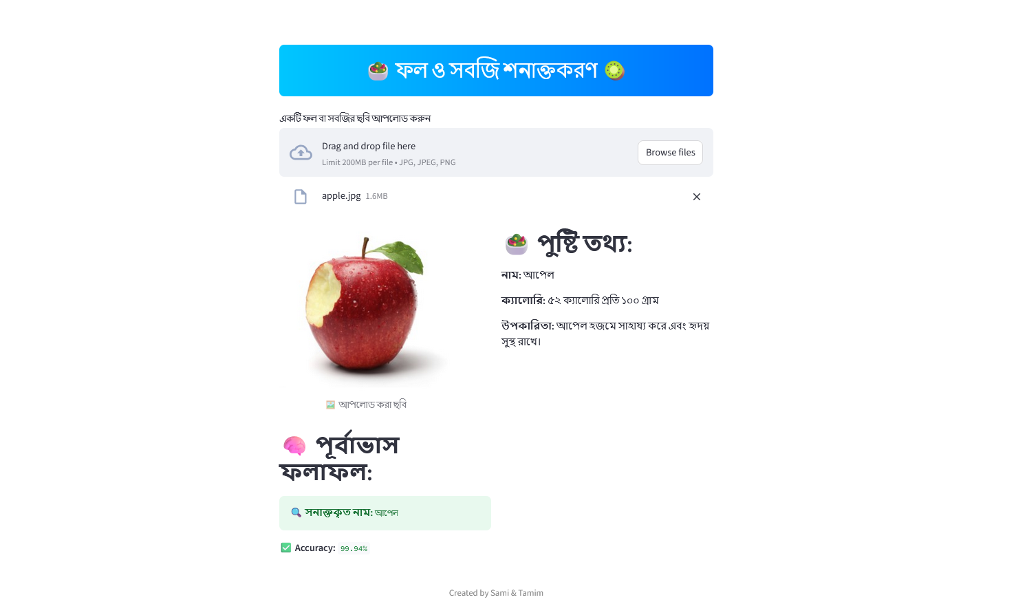
User Interface

Slide 8
Conclusion
We made a model that can tell which fruit or vegetable is in a picture. It also shows Bangla nutrition info. Anyone can use it through a web app.

Slide 9
References
TensorFlow. (n.d.). TensorFlow: An end-to-end open-source machine learning platform. Retrieved from https://www.tensorflow.org/
Keras. (n.d.). Keras API reference. Retrieved from https://keras.io/
Python Software Foundation. (n.d.). Python Programming Language. Retrieved from https://www.python.org/
Matplotlib Developers. (n.d.). Matplotlib: Visualization with Python. Retrieved from https://matplotlib.org/
Pandas Development Team. (n.d.). pandas: Powerful data analysis toolkit. Retrieved from https://pandas.pydata.org/
NumPy Developers. (n.d.). NumPy: Fundamental package for scientific computing. Retrieved from https://numpy.org/
Streamlit Inc. (n.d.). Streamlit: The fastest way to build data apps. Retrieved from https://streamlit.io/

Slide 10
Thank you
Any Questions?

